Slide 1
Ch-1 The 8086 microprocessor

Slide 2
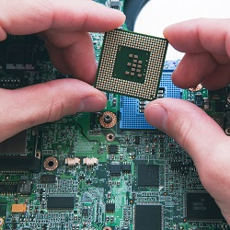
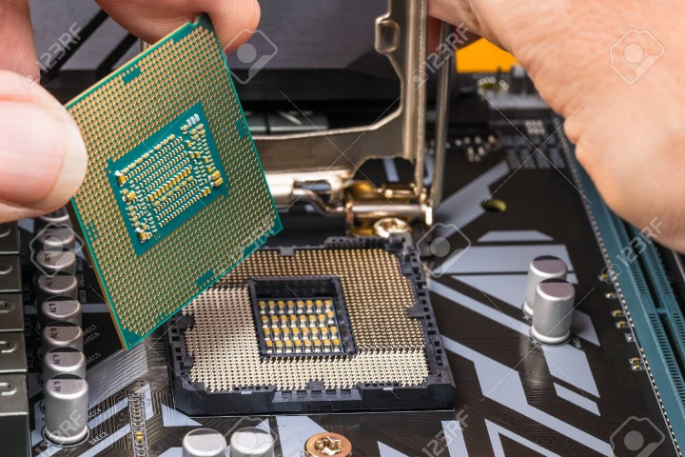
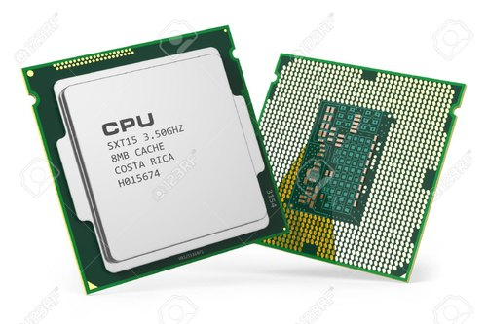
Microprocessor
A microprocessor is an electronic component that is used by a computer to do its work.
It is a central processing unit on a single integrated circuit chip containing millions of very small components including transistors, resistors, and diodes that work together.
The microprocessor is the central unit of a computer system that performs arithmetic and logic operations, which generally include adding, subtracting, transferring numbers from one area to another, and comparing two numbers.
It's often known simply as a processor, a central processing unit, or as a logic chip.

Slide 3
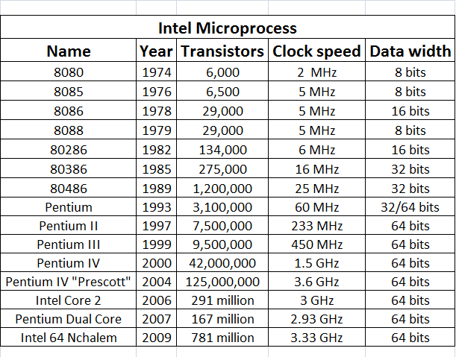
Evolution of Microprocessor

Slide 4
Basic Functions of processor
Programmer write a program using HLL or ALP(instructions)
Assembler will convert HLL/ALP into machine code.(opcode of instructions (hex))
Loader is responsible to load program into memory (binary form)
Memory
0000
0001
Processor
* Individual location size of memory is always 1Byte i.e. 8 bits.
* Entire memory size of memory is depend upon the address bus size of processor.
0002
Address bus / Data bus
FFFF
Processor calculates the memory address and fetch the content of that memory location.
Processor decodes the fetched instruction and execute it.
Content of memory location can be Data/instructions

Slide 5
Features of 8086
Explain features of 8086 ( each for 2 marks)
Basic Features
Special Features
Miscellaneous Features

Slide 6
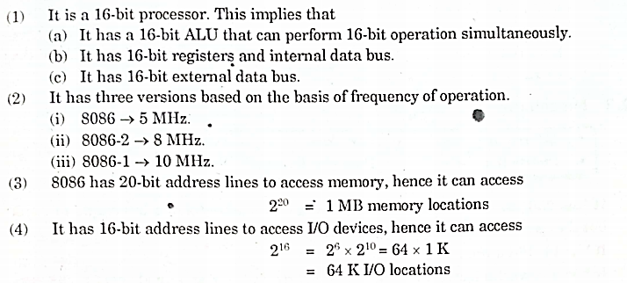
Basic Features
Processor Size
Speed of processor
Address bus size for memory
Address bus size for I/O

Slide 7
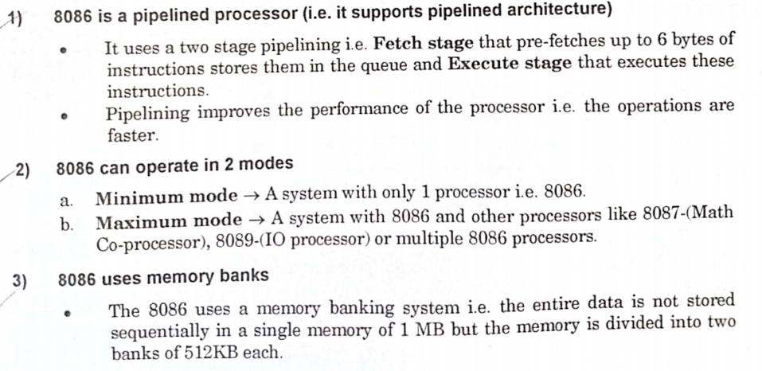
2. Special Features
8086 is a pipelined processor
8086 can operate in 2 modes
8086 uses memory banks
8086 uses memory segmentation
8085
Fetch
Decode
Execute
At a time only 1 instruction
8086
F
D
E
F
D
E
At a time 2 instruction

Slide 8
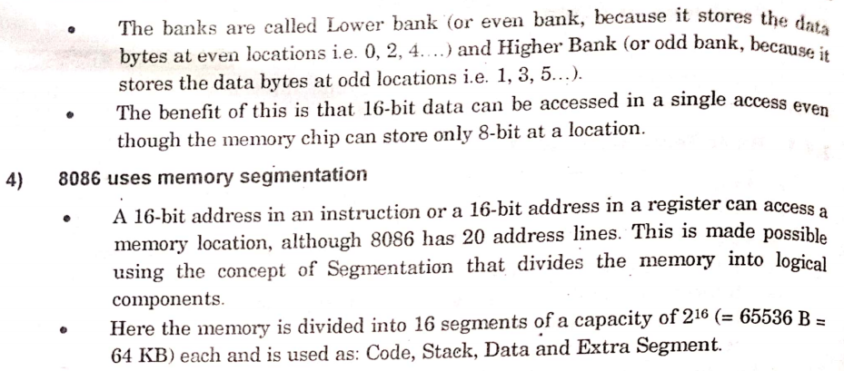

Slide 9
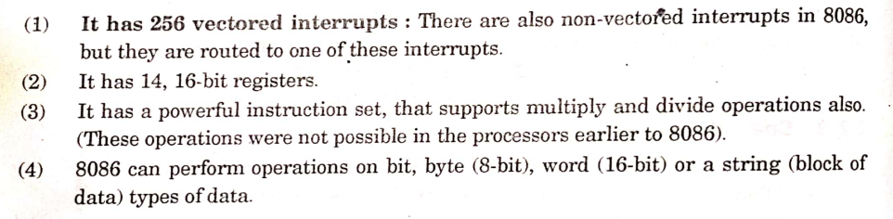
3. Miscellaneous Features
Interrupts
Registers
Instruction set
Data size for ALU

Slide 10
Architecture of 8086
Draw and explain architecture of 8086
Diagram –
Explanation –
Main task of Processor :
Draw architecture of 8086 and explain any one unit
Diagram –
Explanation –
Fetch
Decode
Execute
Draw architecture of 8086 ( 3 marks)
To understand any architecture we must know :
How do you fetch the instruction?
Where is getting decoded?
Where is getting executed?

Slide 11
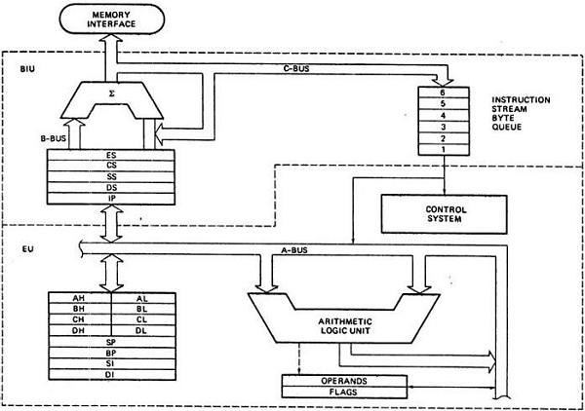
8086 is 16 bit processor
Why in two parts????
Pipelining
PA= seg x 10h + offset
6 Bytes
(16 )
(16 )
(16 )
(16 )
BUS INTERFACE UNIT
(16 )
AX (16 )
(8 )
(8 )
BX (16 )
(8 )
(8 )
CX (16 )
(8 )
(8 )
ALU
(16 )
DX (16 )
(8 )
(8 )
(16 )
(16 )
(16 )
(16 )
(16 )
EXECUTION UNIT
(16 )

Slide 12
Pipelining :
8085
Fetch
Decode
Execute
Pipelining is one of the special feature of 8086 processor.
Due to pipelining 8086 processor architecture is divided into two parts.
BIU will fetch the instruction from memory and it will pass that fetched instruction to the Execution unit.
While execution unit executes the current instruction BIU will fetch the next instruction.
Pipelining helps in order to increase the speed of processor.
At a time only 1 instruction
8086
F
D
E
F
D
E
At a time 2 instruction
Back

Slide 13
Operand 1
Operand 2
In the architecture diagram of 8086 everything is in rectangle except two following shapes.
This the diagram of arithmetic circuit.
In the given circuit there are two inputs which are used to take operand values.
operation will be performed on input operands and it will produce output.
For example 3 + 4
3
4
Σ
3 + 4
***In the architecture of 8086 there are two such type of circuits are available from that one is ALU who is responsible to perform arithmetic operations and another one is to calculate memory address.
7
Output
Back

Slide 14
There is an instruction ADD AL, BL ( wants to add content of AL reg with content of BL register)
This instruction will be loaded into the memory
Memory
Processor will fetch this instruction from memory and to perform fetching processor has to calculate the physical address of that memory location.
0000
0001
ADD AL, BL
0002
Hence arithmetic circuit in upper section is responsible to calculate the physical address of memory location where instruction is stored.
FFFF
ALU which is present at lower section i.e. in execution unit is responsible to perform actual addition of reg AL and BL data.
How to calculate physical address ????????

Slide 15
PA= Seg x 10h + offset
Formula to calculate physical address of memory location is :
Overview of memory segmentation:
Example :
00000
Memory
There is a book which has 1000 pages.
Assume there are 10 chapters and each chapter has 100 pages.
We want to go on page no. 564.
There are two methods :
This is entire memory supported by 8086.
The amount of memory that you can access is depend upon the address size of processor. 8086 has 20 bit address bus hence entire memory size is 1 MB
CS
IP
Code
Ss
Example :
SP
Stack
If you want to access any file from your hard disk you will access that file from file name.
We don’t know the physical address of that file.
We know the logical address i.e. name
DS
1
Directly call 564
SI
Data
5 th chapter
64 page
2
CS
IP
In 8086 memory is divided into 4 part i.e. segments
Assume: CS= 1000 & IP= 2345
Extra
If you want to access any location of memory which will have its unique physical address.
We give segment address (starting addr of segment) and
offset addr (location within particular segment)
DI
Extra
PA = Seg x 10H + offset
1000 x 10H + 2345
10000 + 2345
PA = 12345 H
FFFFF

Slide 16
Physical addr
Output
Σ
Operand 1
Operand 2
ES (16)
CS (16)
SS (16)
DS (16)
IP (16)
These are the registers which are used to stored starting address of segments
Back

Slide 17
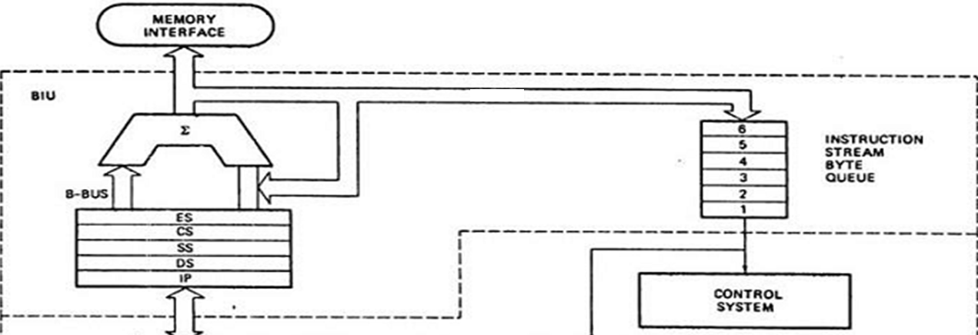
Functions of BIU :
Fetch the next Instruction from memory
Calculate the Physical Addr
Manage the instruction queue.
Managing of queue :
Processor fetch the next instruction and calculate the physical addr of that instruction.
After PA calculation processor will transfer that instruction into instruction queue through data bus (16 bit). This phase is called as prefetching phase.
Maximum size of instruction queue is 6 bytes.
All instructions are in different size :
1) ADD BL,CL : 1 byte
2) ADD CL, 02H : 2 bytes
3) ADD AX, 2000H : 3 bytes
1
2
3
4
5
6
7
8
9
.
.
EI
How many Instructions are in the queue?????
(nobody knows)
6 bytes of program
How many bytes are in the queue?????
(6 bytes)
Smallest instruction of 8086 is 2 bytes
Biggest instruction of 8086 is 6 bytes
when EU executing the next instruction BIU fetch the next 6 bytes of program

Slide 18
8086 has 6 bytes instruction queue
It is FIFO type of queue i.e. First In First Out
Processor will fetch the next 6 bytes and store into the queue. EU removes one by one each byte for execution
Smallest instruction of 8086 is 2 bytes
Biggest instruction of 8086 is 6 bytes
Queue
Memory
6
5
4
3
2
1
When BIU will refill the queue???
2
First our for execution
1
1
After one byte empty
3
2
1
When BIU will refill the queue???
3
2
When all 6 bytes are transferred
When 2 bytes are transferred for execution.
3
When 2 bytes are transferred for execution. Because the smallest instruction of 8086 is 2 bytes
4
5
4
1
5
2
6
6
3
When first entered element removed for execution
4
First our for execution

Slide 19
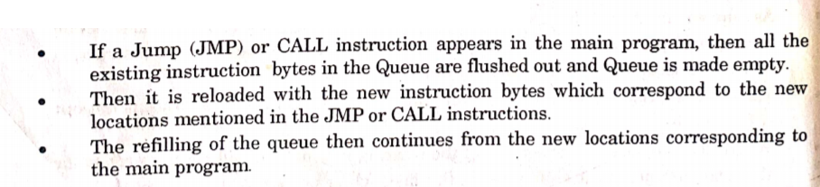

When pipeline fails ???
Queue
6
5
JMP
4
3
2
1

Slide 20
1.BIU calculates the physical addr of this instruction (Add BL,CL) and fetch it from memory
8086 is 16 bit processor
2. Instruction will transfer into instruction Queue through data bus
3. There is a intermediate phase between fetching and executing is called decoding which is done by control system
Why in two parts????
Add BL , CL
6 Bytes
PA= seg x 10h + offset
Add BL , BL
(16 )
(16 )
9. Control system send notification to BL reg about the output because result is always stored into 1st operand register
(16 )
5. Control System produces signal for reg. BL and CL to inform about the operation.
4.Decoding means identify the operation of an instruction and inform to execution unit about it
(16 )
(16 )
Add BL , CL
07
7. Control system again inform to ALU about floating data
AX (16 )
(8 )
(8 )
04
07
BX (16 )
03
03
Mov BL, 03
Mov CL, 04
Add BL , CL
(8 )
(8 )
03
07
04
CX (16 )
(8 )
(8 )
04
(16 )
DX (16 )
(8 )
(8 )
10. BL replace output with its previous value
(16 )
(16 )
07
8. ALU take both operands and performs addition float the output on database
(16 )
6. After receiving signal about the operation Reg. BL and CL float there content on data bus and also keep original value.
(16 )
(16 )
(16 )

Slide 21
Draw and explain architecture of 8086

Slide 22

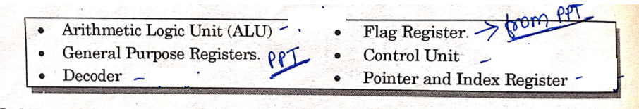
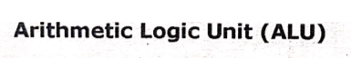
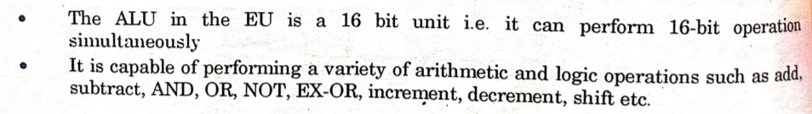


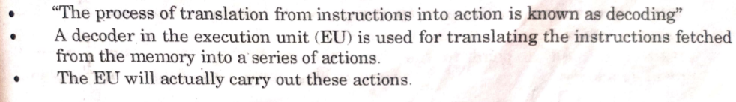

Slide 23

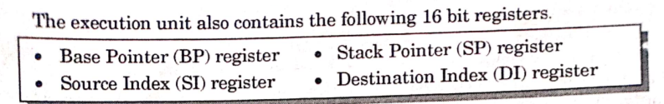
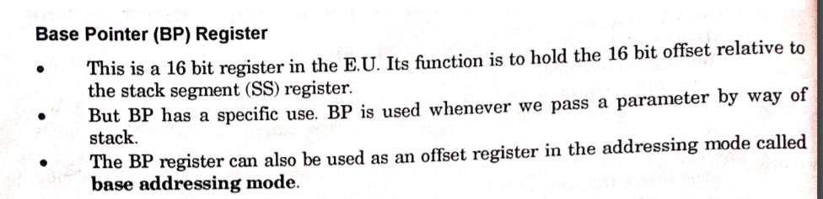
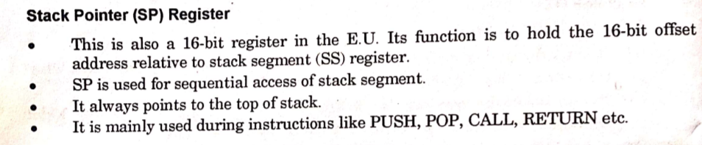

Slide 24
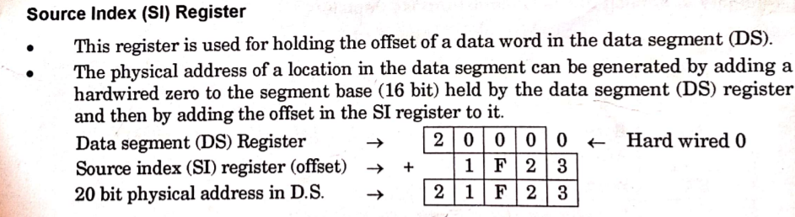
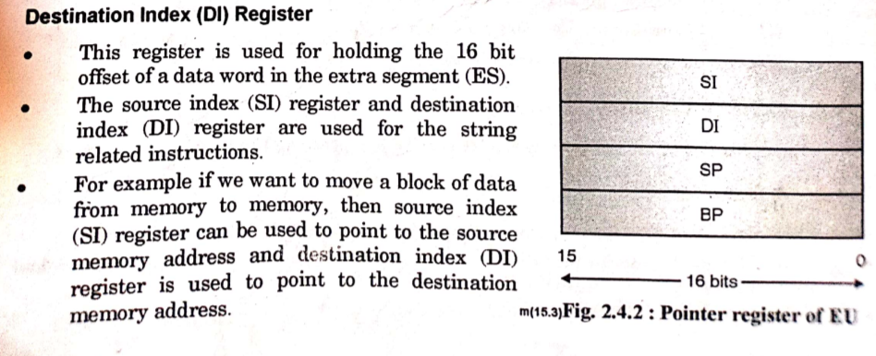

Slide 25
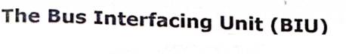
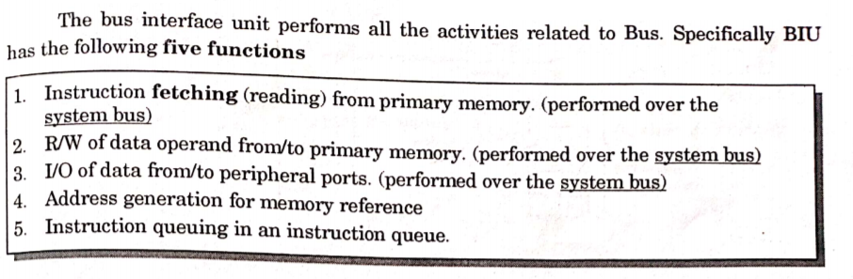
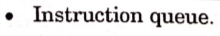
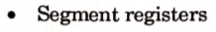

Slide 26
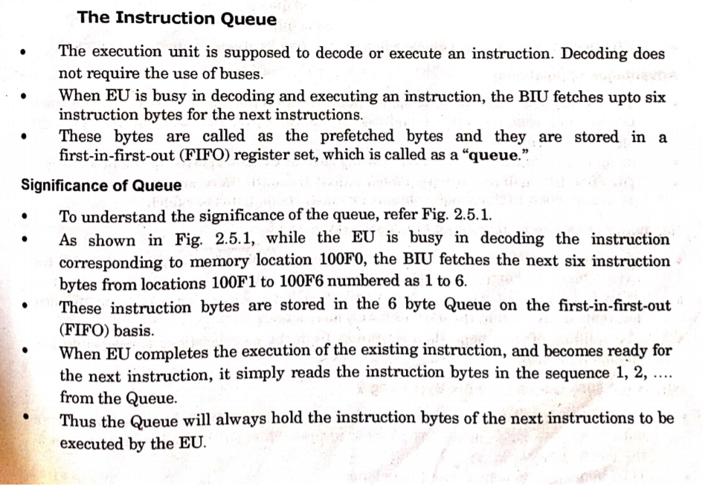
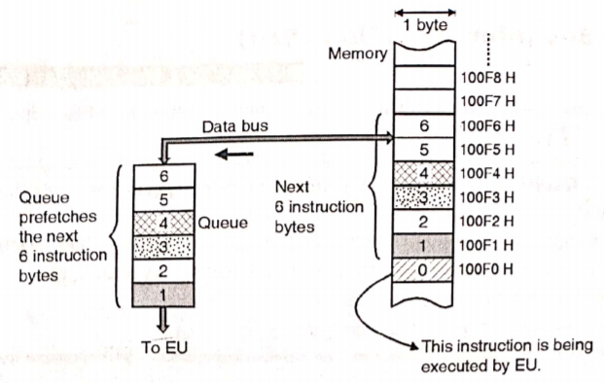

Slide 27
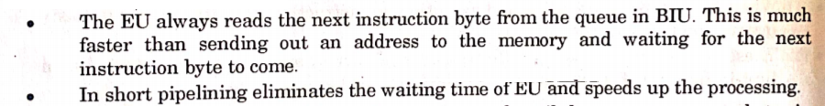
Pipelining :
8085
Fetch
Decode
Execute
Pipelining is one of the special feature of 8086 processor.
Due to pipelining 8086 processor architecture is divided into two parts.
BIU will fetch the instruction from memory and it will pass that fetched instruction to the Execution unit.
While execution unit executes the current instruction BIU will fetch the next instruction.
Pipelining helps in order to increase the speed of processor.
At a time only 1 instruction
8086
F
D
E
F
D
E
At a time 2 instruction
Advantages of Pipelining :

Slide 28
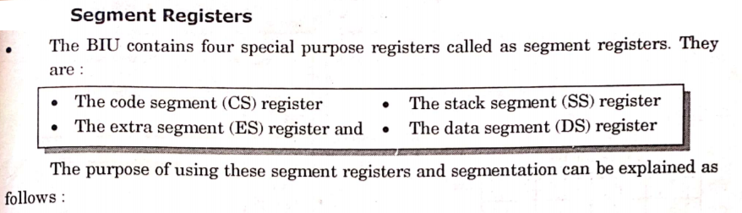
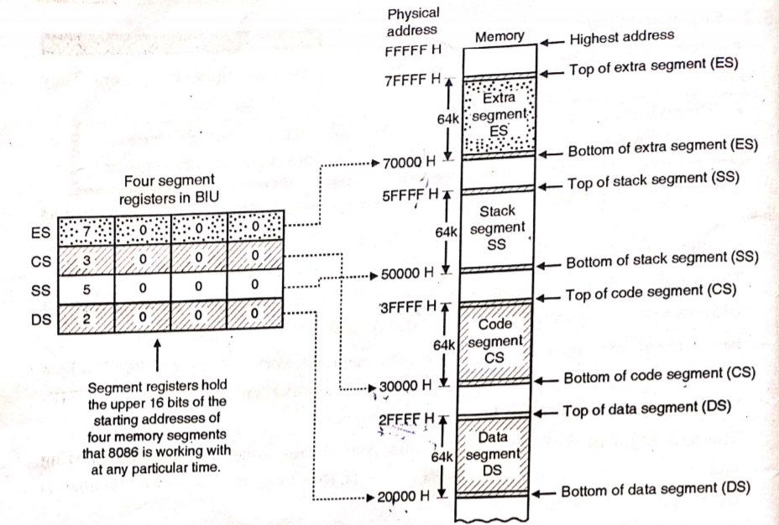

Slide 29
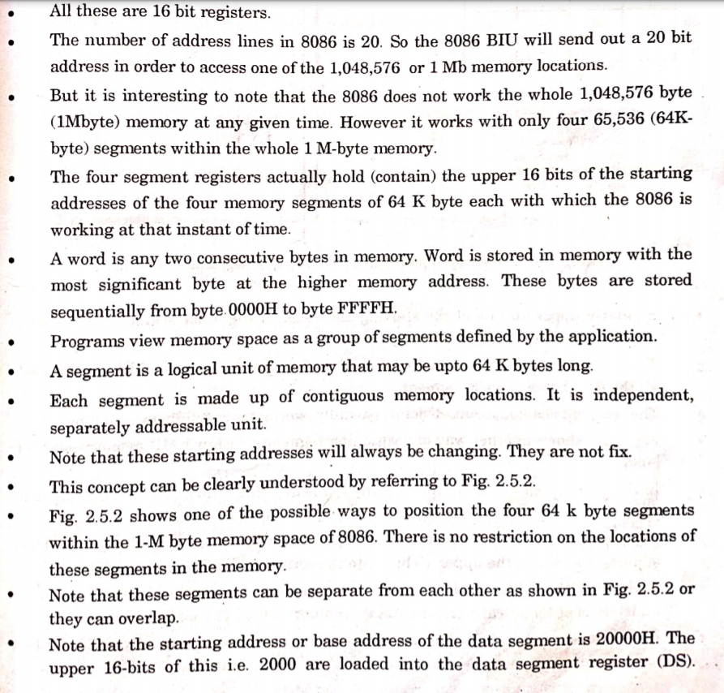

Slide 30
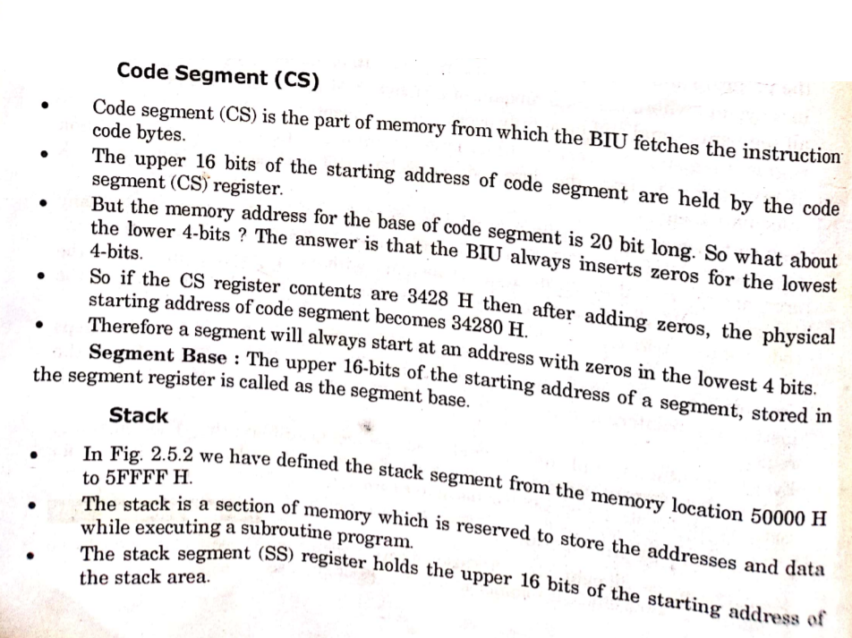

Slide 31
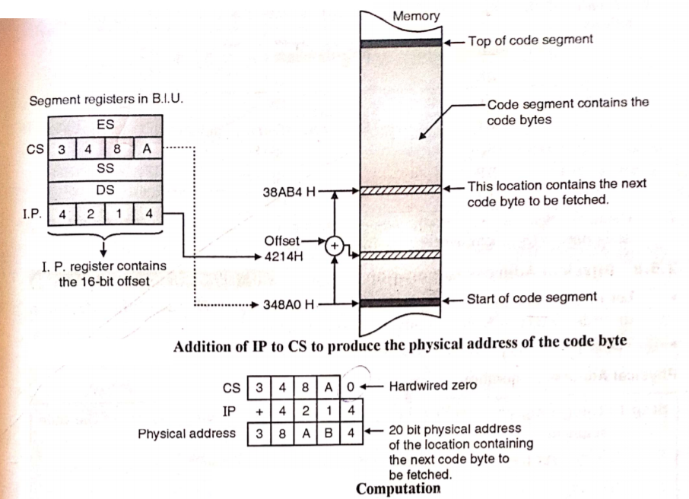

Slide 32
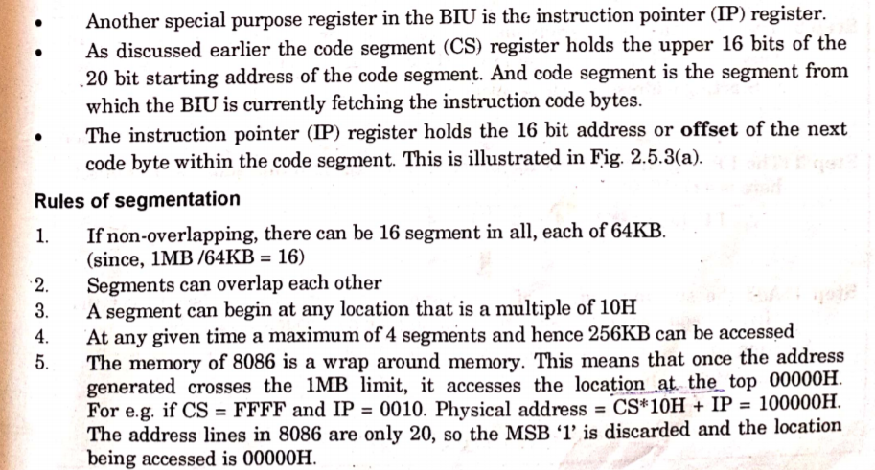

Slide 33
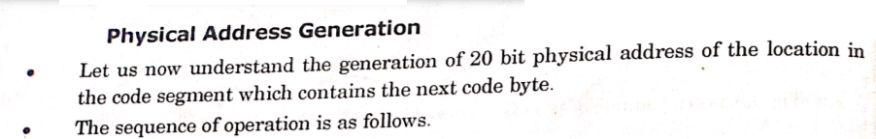

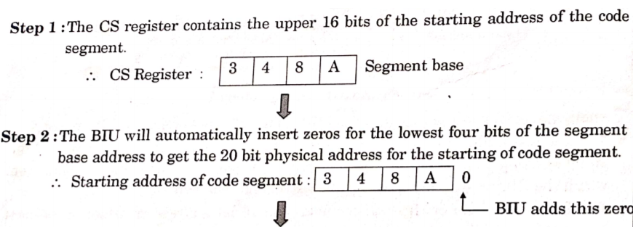
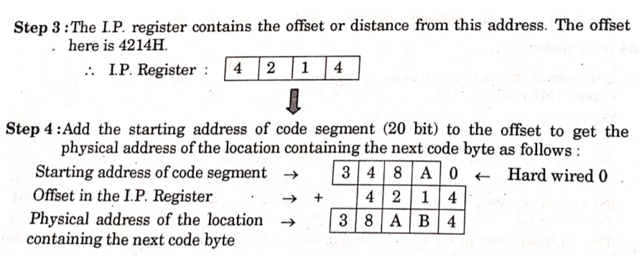

Slide 34
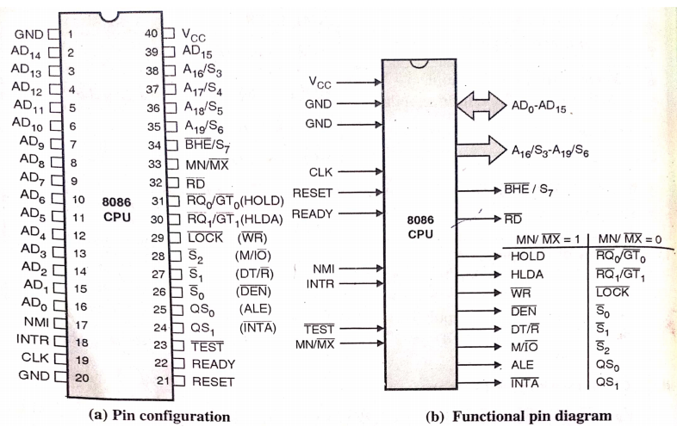
Pin diagram of 8086
For Exam

Slide 35
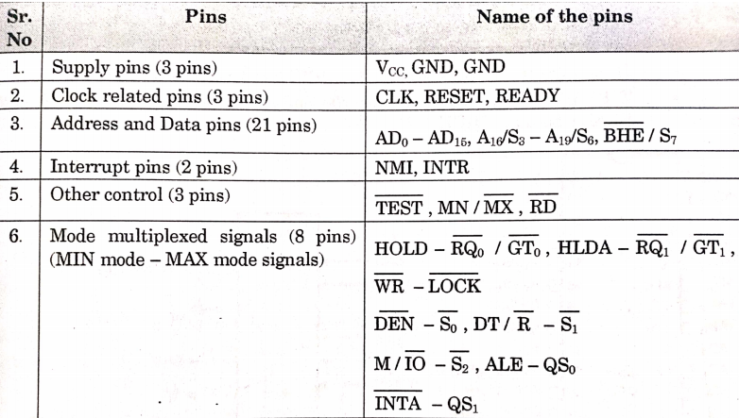

Slide 36
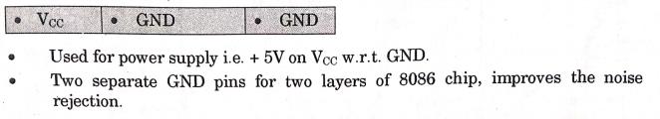
1. Supply Pins (3) :

Slide 37
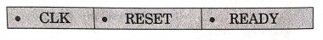
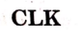
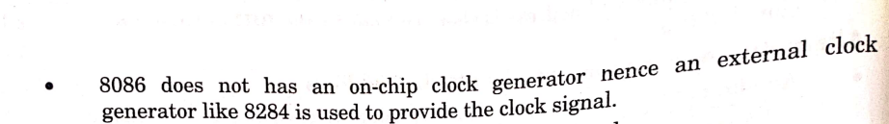

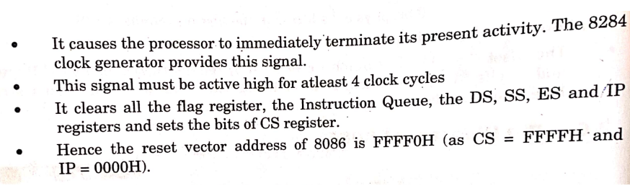
2. Clock related Pins (3) :

Slide 38

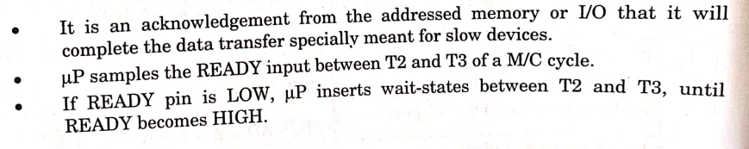

Slide 39
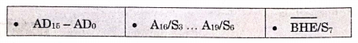
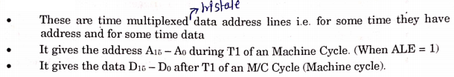
3. Address and Data Pins (3) :
When enable then only output appears on output line
Buffer
0
0
I/P
O/P
1
1
Tristate
Buffer
This concept is used in ALE i.e Address Latch Enable (to latch the address
T1
T2
T3
T4
1
How to differentiate between data and address ???
1. Address calculation
1 clock cycle = 1 T state
0
1
Address Bus
A15-A0
D15-D0
Something is high which indicates that bus carries the address.
0
ALE
When ALE = 1 : Address bus (A15-A0)
Pass 0 signal and wait
2. Data
When ALE = 0 : Data bus (D15-D0)
Pass 1 signal and wait

